Slide 1
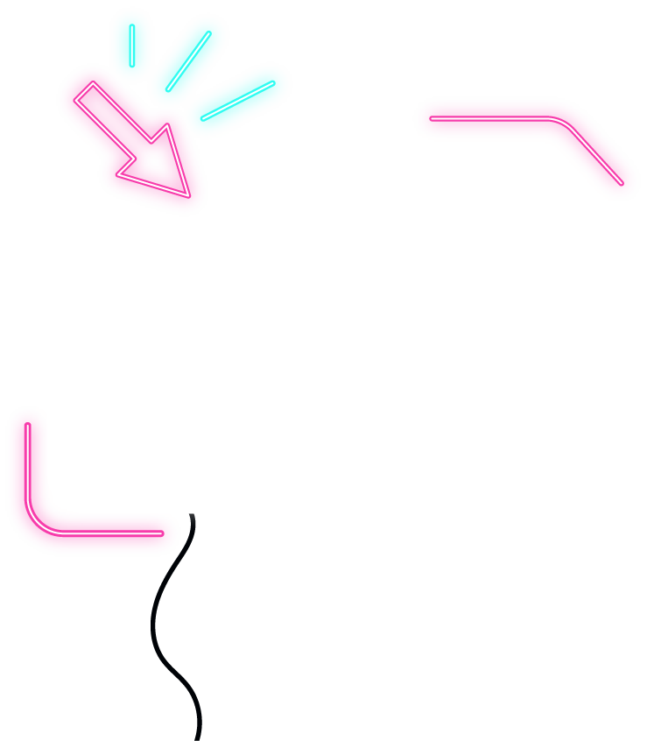






IOT WORKLOAD CHARACTERIZATION IN NEXT GENERATION CLOUD SYSTEMS UPDATE
Supervised by: Dr. Karan Mitra, Dr. Saguna Saguna,
Dr. Christer Åhlund
Presented by: Fatema Mirza

Slide 2






Latest additions
TABLE OF CONTENTS
fatmir-0@student.ltu.se

Slide 3
01
Latest additions
fatmir-0@student.ltu.se

Slide 4
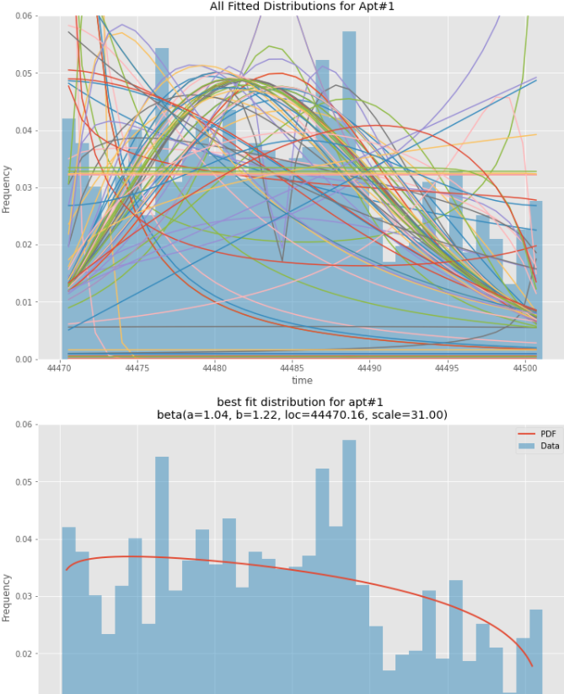
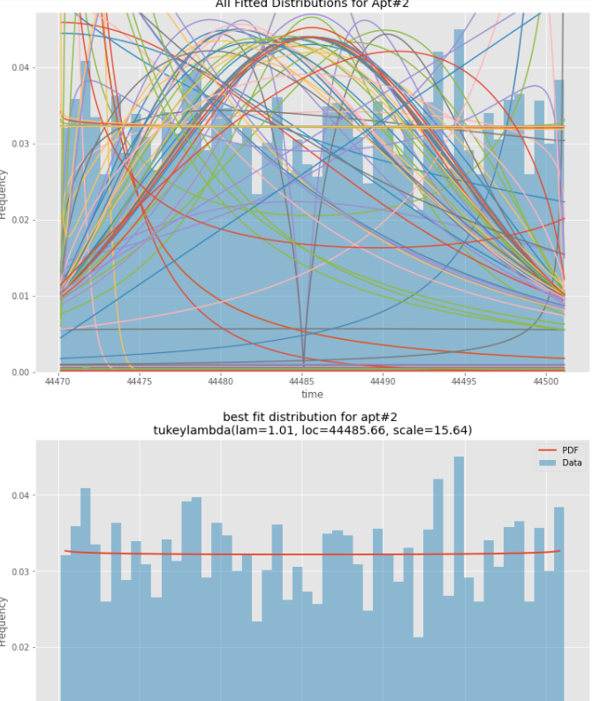
Individual Apartments
fatmir-0@student.ltu.se 25/02/2022 | 07

Slide 5
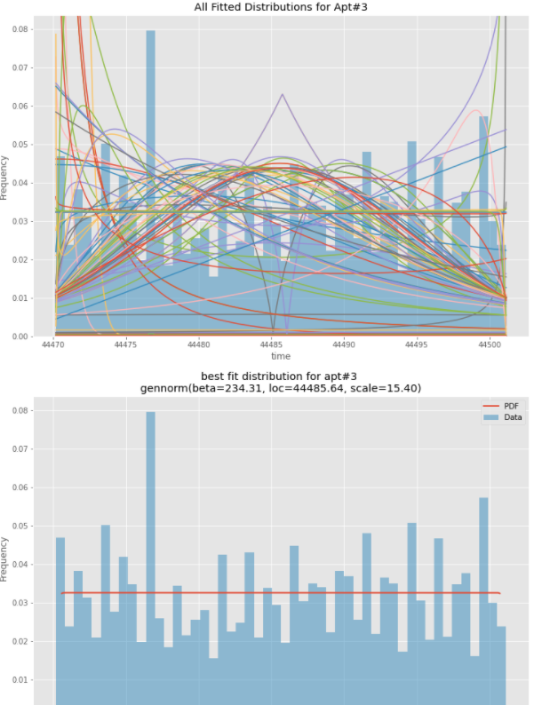
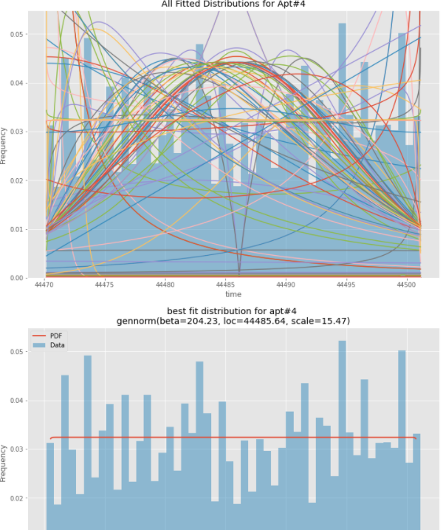
Individual Apartments
fatmir-0@student.ltu.se 25/02/2022 | 07

Slide 6
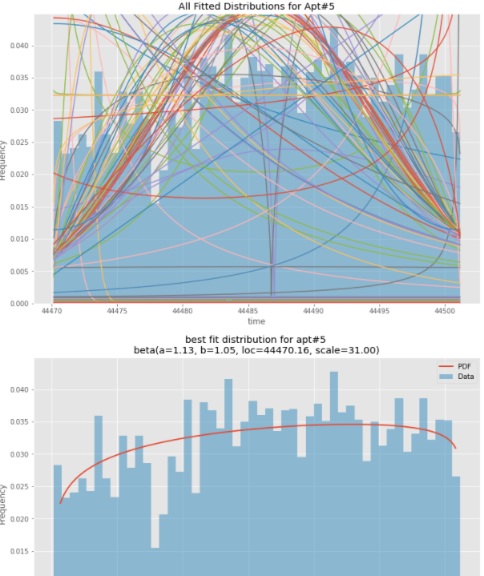
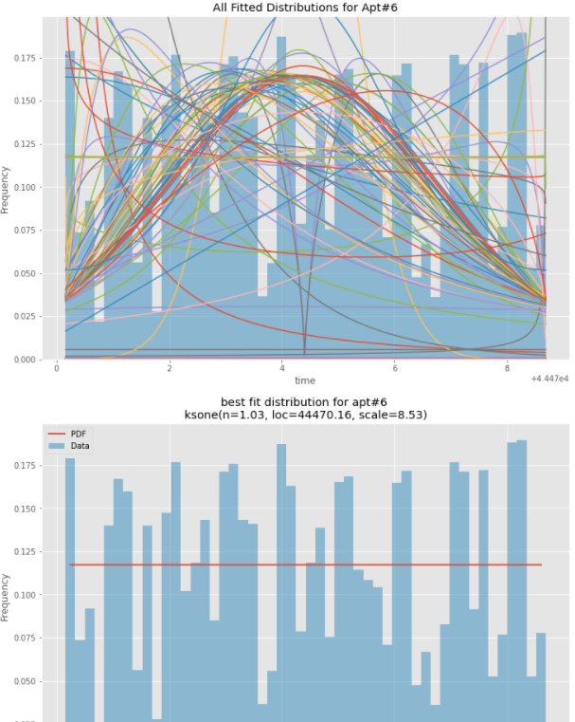
Individual Apartments
fatmir-0@student.ltu.se 25/02/2022 | 07

Slide 7
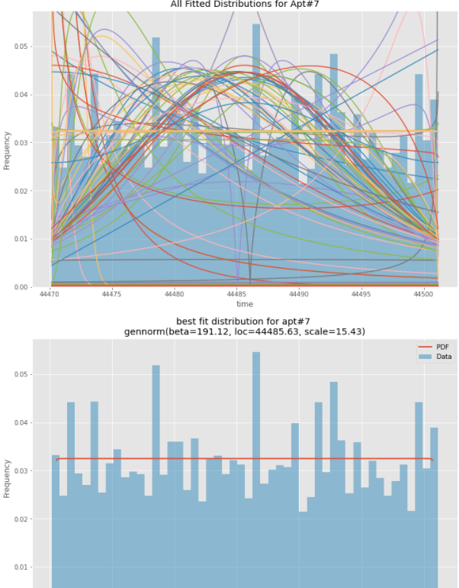
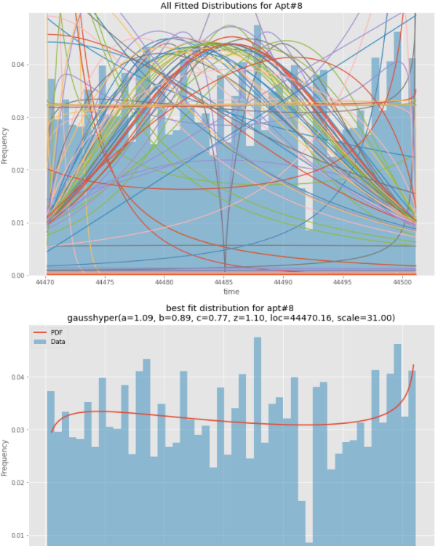
Individual Apartments
fatmir-0@student.ltu.se 25/02/2022 | 07

Slide 8
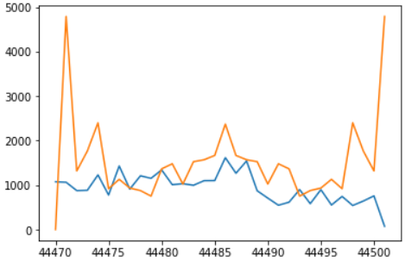
Fast Fourier Transformation
fatmir-0@student.ltu.se 25/02/2022 | 07

Slide 9
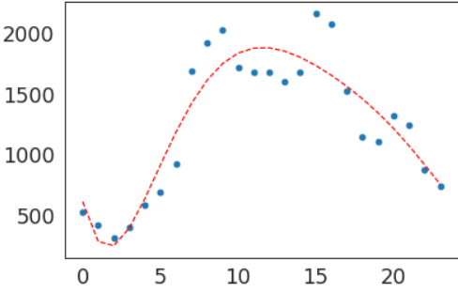
Polynomial Equation for 6
fatmir-0@student.ltu.se 25/02/2022 | 07

Slide 10
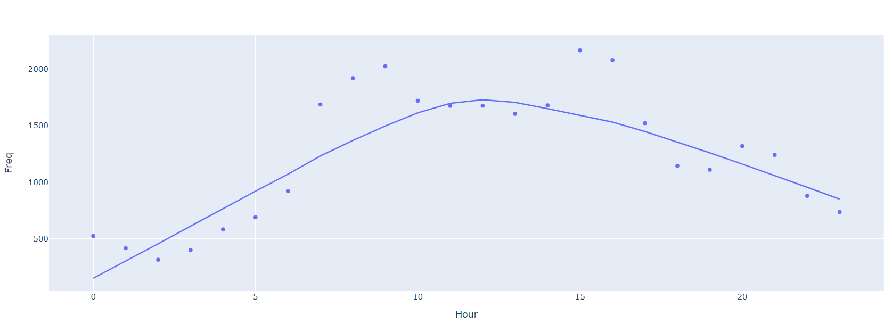
Polynomial Equation for 6
Lowess trendline
fatmir-0@student.ltu.se 25/02/2022 | 07
Notes:
Locally Weighted Scatterplot Smoothing

Slide 11
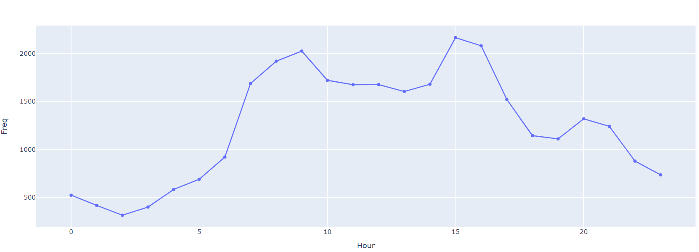
Polynomial Equation for 6
Lowess trendline with fraction 0.1
fatmir-0@student.ltu.se 25/02/2022 | 07
Notes:
Locally Weighted Scatterplot Smoothing

Slide 12
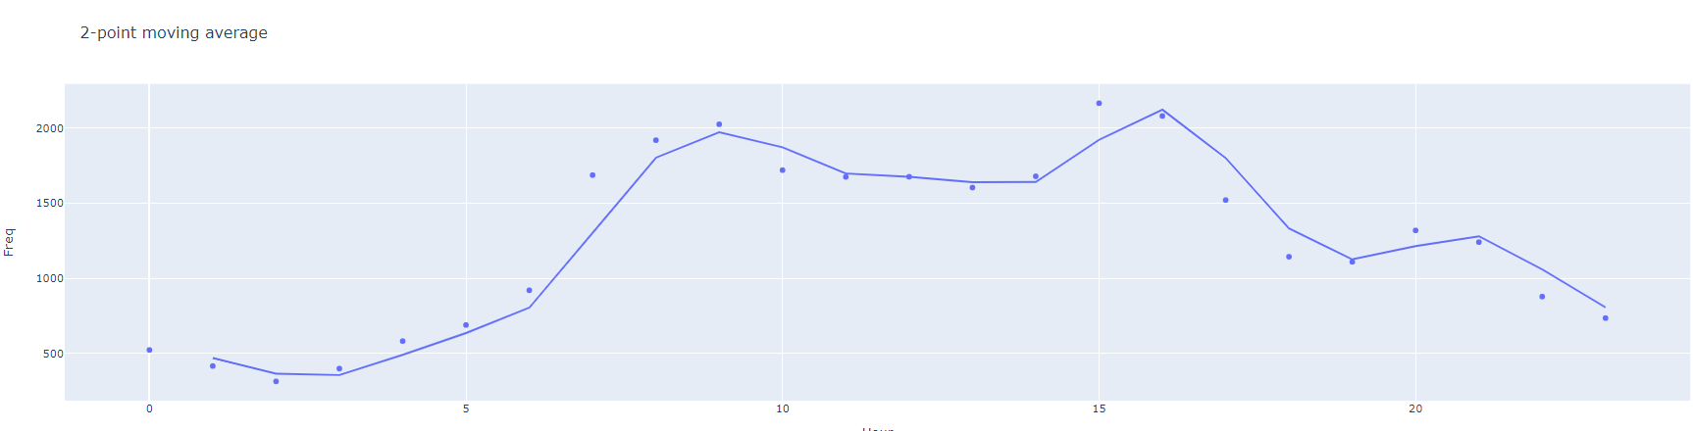
2-point moving average
fatmir-0@student.ltu.se 25/02/2022 | 07

Slide 13
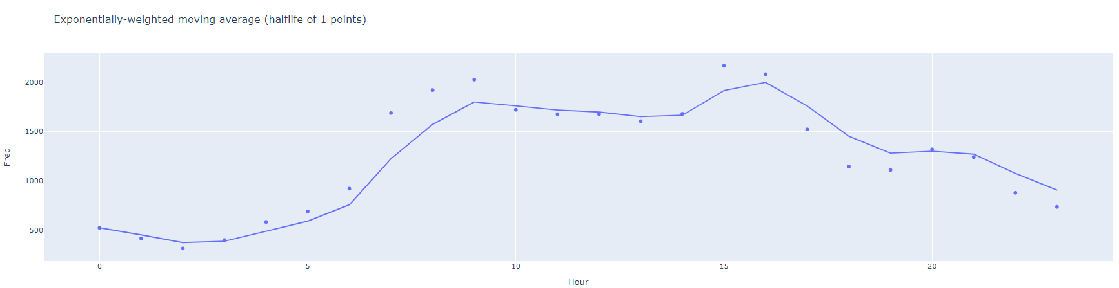
Exponentially-weighted moving average (halflife of 1 points)
fatmir-0@student.ltu.se 25/02/2022 | 07

Slide 14
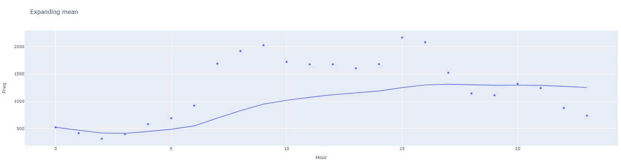
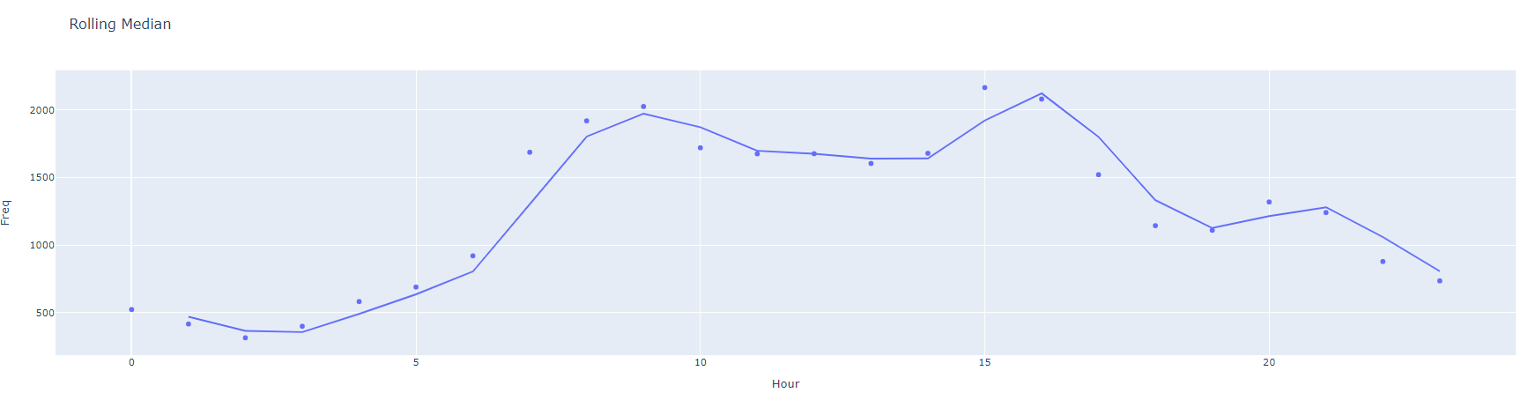
Expanding mean
fatmir-0@student.ltu.se 25/02/2022 | 07

Slide 15
Rolling Median
fatmir-0@student.ltu.se 25/02/2022 | 07

Slide 16
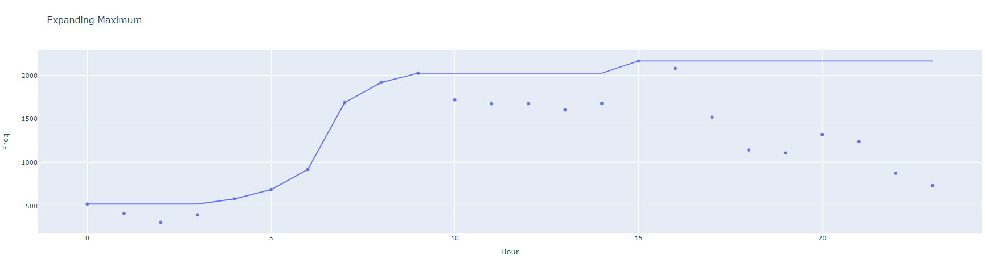
Expanding Maximum
fatmir-0@student.ltu.se 25/02/2022 | 07

Slide 17
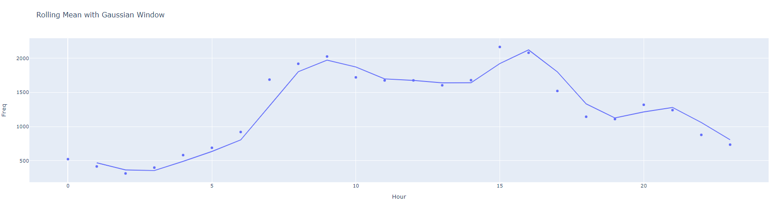
Rolling Mean with Gaussian Window
fatmir-0@student.ltu.se 25/02/2022 | 07

Slide 18
Granularity research
How will Your Workload Look Like in 6 Years? Analyzing Wikimedia's Workload | Days, hours, minutes
A Performance Evaluation Framework for Auto-Scaling Strategies in Cloud Applications | Days
TASM: technocrat ARIMA and SVR model for workload prediction of web applications in cloud | 10 minutes
An adaptive prediction approach based on workload pattern discrimination in the cloud | 5 minutes
A reliable and cost-efficient auto-scaling system for web applications using heterogeneous spot instances | seconds
Analysis and Characterization of a Video-on-Demand Service Workload | hourly
Optimizing Workload Category for Adaptive Workload Prediction in Service Clouds | 10 minutes
Comparing Model-Based Predictive Approaches to Self-Adaptation: CobRA and PLA | 10 minutes
fatmir-0@student.ltu.se 25/02/2022 | 07

Slide 19
Granularity research cont.
Measuring Cloud Workload Burstiness | minutes, hours
Kriging-Based Self-Adaptive Cloud Controllers | 30 minutes
CloudInsight: Utilizing a Council of Experts to Predict Future Cloud Application Workloads | Second, days, hour
Online Spike Detection in Cloud Workloads | minute
Forecasting Cloud Application Workloads with CloudInsight for Predictive Resource Management | seconds
Non-linear analysis of bursty workloads using dual metrics for better cloud resource management | minute
An Attribute-Based Availability Model for Large Scale IaaS Clouds with CARMA | minute
A Type-Aware Workload Prediction Strategy for Non-stationary Cloud Service | second
fatmir-0@student.ltu.se 25/02/2022 | 07

Slide 20
Granularity research cont.
Workload Characterization, Controller Design and Performance Evaluation for Cloud Capacity Autoscaling | second
Scalability Issues for Remote Sensing Infrastructure: A Case Study | day
An automated forecasting method for workloads on web-based systems | hourly
Traffic Analysis of Two Scientific Web Sites | Day, hour
fatmir-0@student.ltu.se 25/02/2022 | 07

Slide 21

Thank you! Tack så mycket
Any Questions?
fatmir-0@student.ltu.se

Slide 22
References
[1] https://www.youtube.com/watch?v=SqSUJ0UYWMQ
[2] https://techcrunch.com/2014/11/08/littles-law-is-big-for-startups/?guccounter=1&guce_referrer=aHR0cHM6Ly93d3cuZ29vZ2xlLmNvbS8&guce_referrer_sig=AQAAAFvY4BNr5Vvu2uDhXO4VTDuLiVSsISoGSjMxJMxW1Pt6ar11_kEY1wq5aw5HlXlySpE0jUAVwaZrqBu00JlSq7EUCeucjIMrTrHpRp59P000WKfozg64v5gANPPBZ1cB1W72iB8KG7aZ9xlUhU3E68QBMT2CsMngoCUV5UZ2HcNW
[3] Konstantopoulos, T. A review of Burke’s theorem for Brownian motion. Queueing Syst 83, 1–12 (2016). https://doi.org/10.1007/s11134-016-9478-x
[4] Chen H., Yao D.D. (2001) Jackson Networks. In: Fundamentals of Queueing Networks. Stochastic Modelling and Applied Probability, vol 46. Springer, New York, NY. https://doi.org/10.1007/978-1-4757-5301-1_2
[5] M. López-Benítez, C. Majumdar and S. N. Merchant, "Aggregated Traffic Models for Real-World Data in the Internet of Things," in IEEE Wireless Communications Letters, vol. 9, no. 7, pp. 1046-1050, July 2020, doi: 10.1109/LWC.2020.2980272.
[6] M. López-Benítez, C. Majumdar and S. N. Merchant, "Aggregated Traffic Models for Real-World Data in the Internet of Things," in IEEE Wireless Communications Letters, vol. 9, no. 7, pp. 1046-1050, July 2020, doi: 10.1109/LWC.2020.2980272.
[7] ing Yuan, Yu Zheng, Chengyang Zhang, Wenlei Xie, Xing Xie, Guangzhong Sun, and Yan Huang. Tdrive: driving directions based on taxi trajectories. In Proceedings of the 18th SIGSPATIAL International
Conference on Advances in Geographic Information Systems, GIS ’10, pages 99{108, New York, NY, USA,
2010. ACM.
[8] Huang, Jiwei & Li, Songyuan & Chen, Ying & Chen, Junliang. (2018). Performance modelling and analysis for IoT services. International Journal of Web and Grid Services. 14. 146. 10.1504/IJWGS.2018.090742.
[9] Tran-Gia, Phuoc & Hossfeld, Tobias (2021). Performance Modeling and Analysis of Communication Networks
- A Lecture Note. Würzburg University Press. https://doi.org/10.25972/WUP-978-3-95826-153-2
fatmir-0@student.ltu.se 11/02/2022 | 11

